Slide 1
Linear Methods for Regression, Optimization
Yong Peng

Slide 2

Overview
Second learning algorithm of the course: linear regression.
Task: predict scalar-valued targets (e.g. stock prices)
Architecture: linear function of the inputs
While KNN was a complete algorithm, linear regression exemplifies a modular approach that will be used throughout this course:
choose a model describing the relationships between variables of interest
define a loss function quantifying how bad the fit to the data is
choose a regularizer saying how much we prefer different candidate models (or explanations of data)
fit a model that minimizes the loss function and satisfies the constraint/penalty imposed by the regularizer, possibly using an optimization algorithm
Mixing and matching these modular components give us a lot of new ML methods.

Slide 3



Supervised Learning Setup
In supervised learning:
There is input , typically a vector of features (or covariates)
There is target , (also called response, outcome, output, class)
Objective is to learn a function , such that based on some data

Slide 4
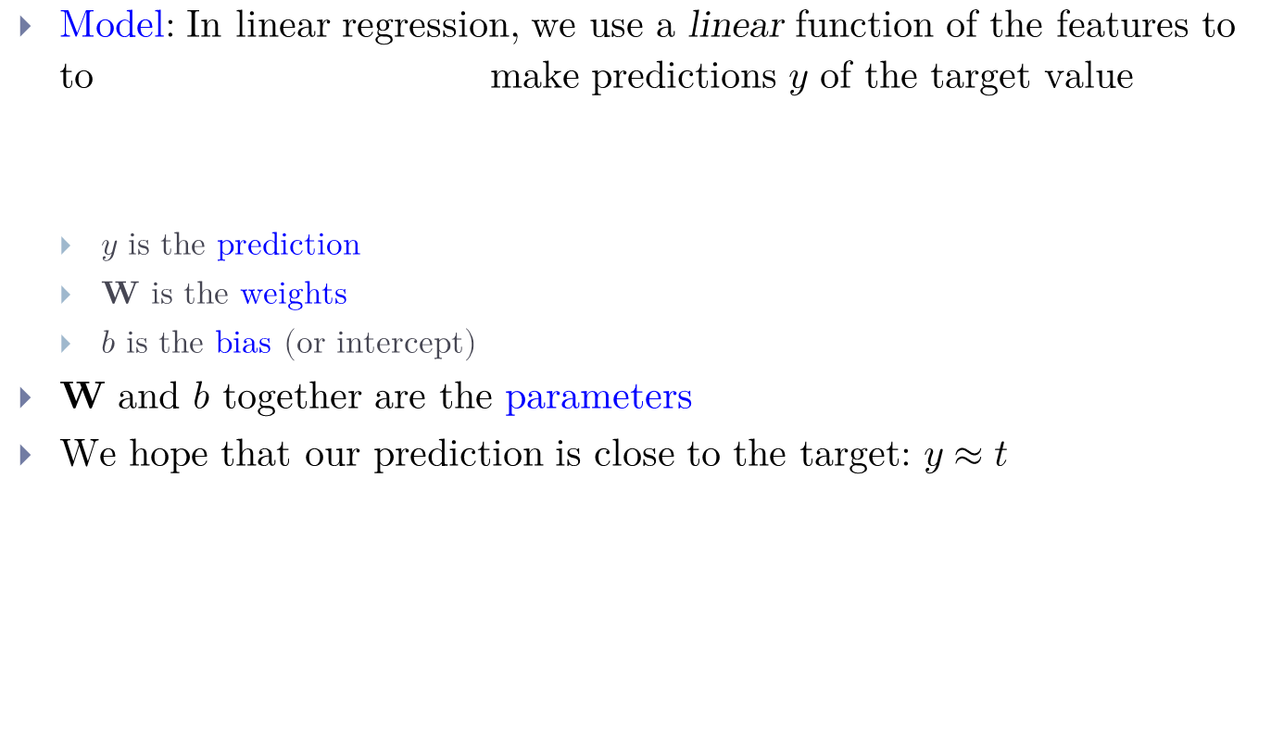

Linear Regression - Model
Model: In linear regression, we use a linear function of the features to to make predictions $y$ of the target value
$y$ is the prediction
$W$ is the weights
$b$ is the bias (or intercept)
$W$and $b$together are the parameters
We hope that our prediction is close to the target: $y≈t$

Slide 5
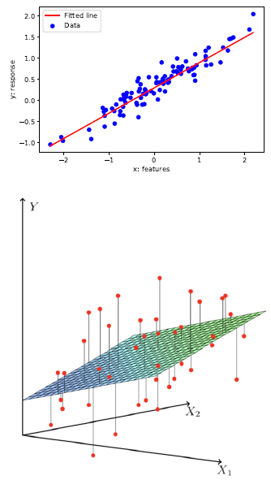
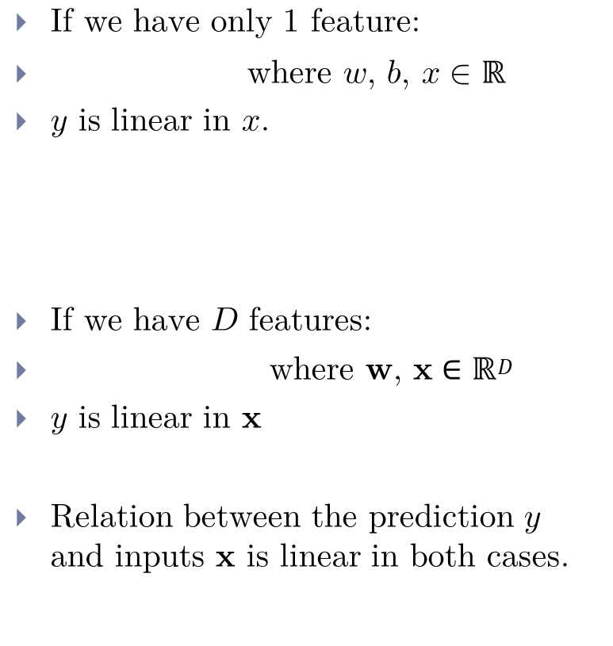
What is Linear? 1 feature vs D features
If we have only 1 feature:
where $w$, $b$, $x∈ℝ$
$y$ is linear in $x$.
If we have $D$ features:
where $w$, $x∈ℝ^{D}$
$y$ is linear in $x$
Relation between the prediction $y$ and inputs $x$ is linear in both cases.

Slide 6
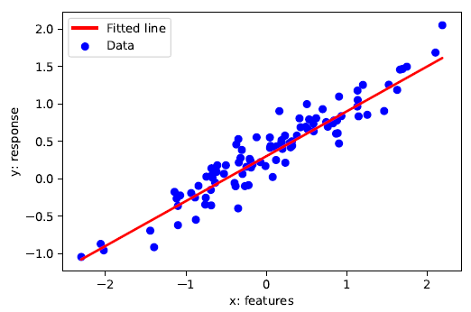




Linear Regression
We have a dataset where
are the inputs (e.g., age, height)
is the target or response (e.g., income)
Predict with a linear function of
Different define different lines
We want the “best” line .
How to quantify the “best”?

Slide 7
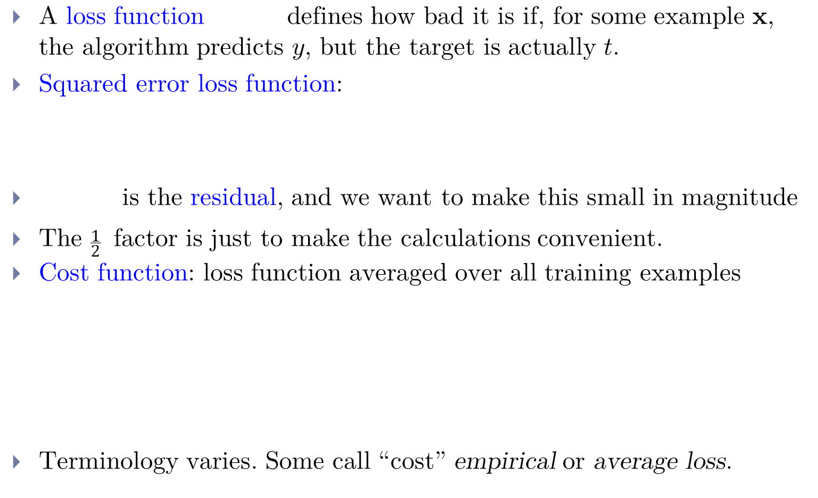




Linear Regression - Loss Function
A loss function defines how bad it is if, for some example $x$, the algorithm predicts $y$, but the target is actually $t$.
Squared error loss function:
is the residual, and we want to make this small in magnitude
The $\frac{1}{2}$ factor is just to make the calculations convenient.
Cost function: loss function averaged over all training examples
Terminology varies. Some call “cost” empirical or average loss.

Slide 8

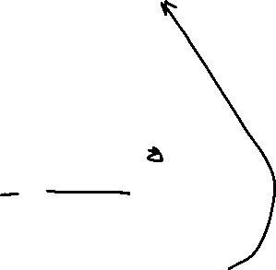
Vectorization
Notation-wise, gets messy if we expand
The code equivalent to compute the prediction using a for loop:
Excessive super/sub scripts are hard to work with, and Python loops are slow, so we vectorize algorithms by expressing them in terms of vectors and matrices.
This is simpler and executes much faster:

Slide 9
Vectorization
Why vectorize?
The equations, and the code, will be simpler and more readable. Gets rid of dummy variables/indices!
Vectorized code is much faster
Cut down on Python interpreter overhead
Use highly optimized linear algebra libraries (hardware support)
Matrix multiplication very fast on GPU (Graphics Processing Unit)
Switching in and out of vectorized form is a skill you gain with practice
Some derivations are easier to do element-wise
Some algorithms are easier to write/understand using for-loops and vectorize later for performance

Slide 10




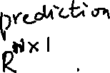
Vectorization
We can organize all the training examples into a design matrix $X$ with one row per training example, and all the targets into the target vector $t$.
Computing the predictions for the whole dataset:

Slide 11
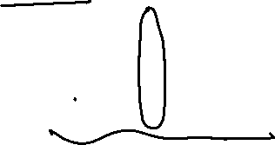


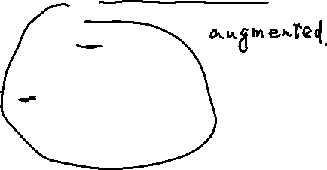
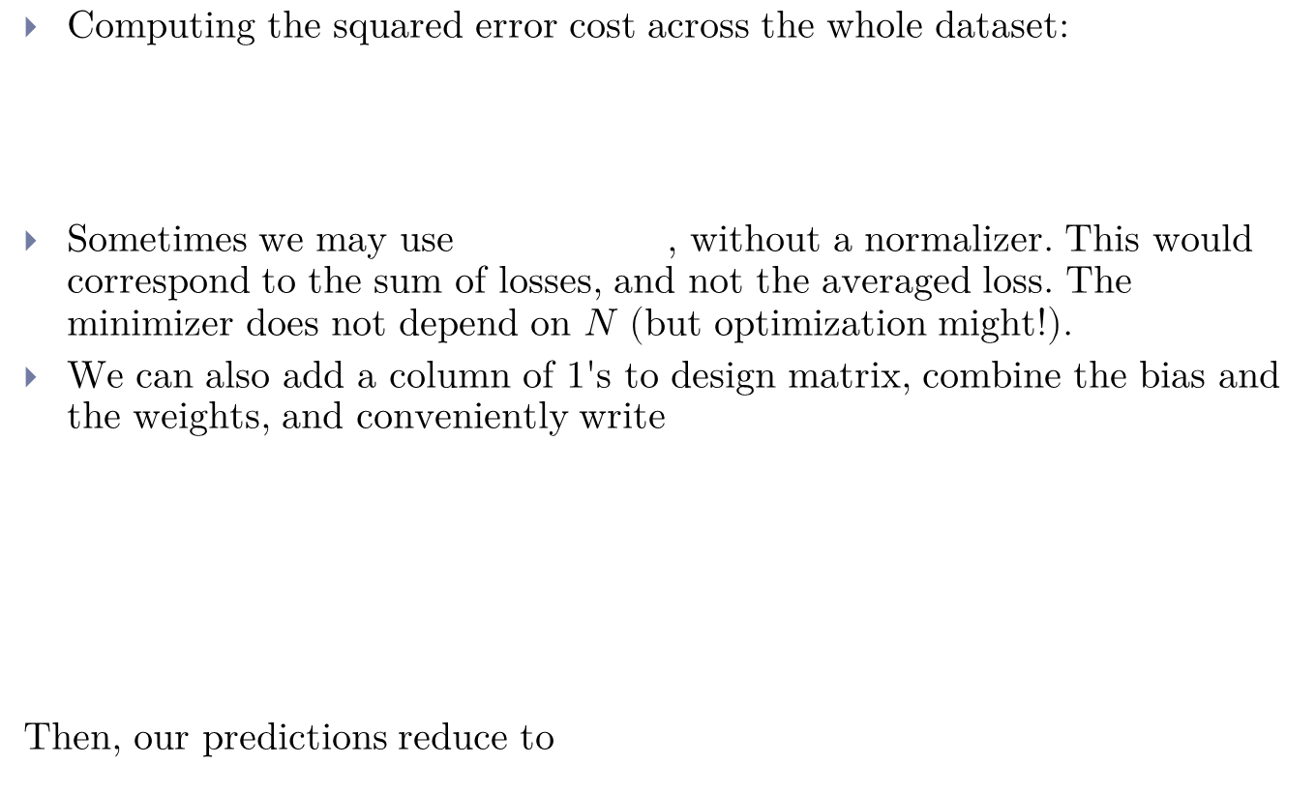

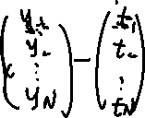
Vectorization
Computing the squared error cost across the whole dataset:
Sometimes we may use , without a normalizer. This would correspond to the sum of losses, and not the averaged loss. The minimizer does not depend on $N$ (but optimization might!).
We can also add a column of 1's to design matrix, combine the bias and the weights, and conveniently write
Then, our predictions reduce to

Slide 12
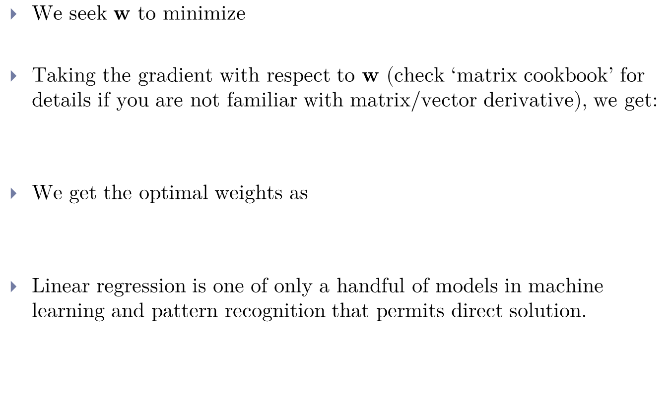

Direct Solution: Calculus
We seek $w$ to minimize
Taking the gradient with respect to $w$ (check ‘matrix cookbook’ for details if you are not familiar with matrix/vector derivative), we get:
We get the optimal weights as
Linear regression is one of only a handful of models in machine learning and pattern recognition that permits direct solution.

Slide 13

Feature Mapping (Basis Expansion)
The relation between the input and output may not be linear.
We can still use linear regression by mapping the input features to another space using feature mapping (or basis expansion).
and treat the mapped feature (in ) as the input of a linear regression procedure.
Let us see how it works when and we use a polynomial feature mapping.

Slide 14
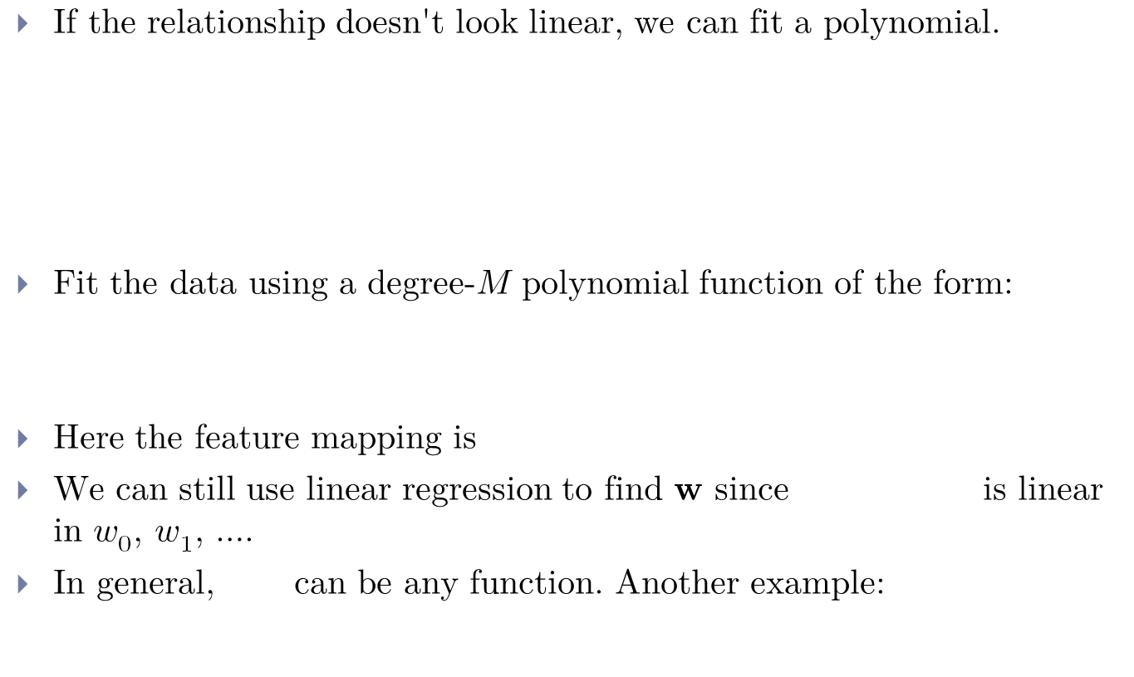

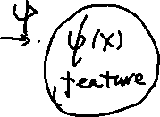
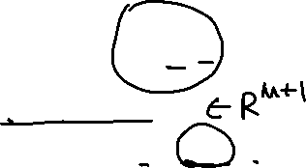
Polynomial Feature Mapping
If the relationship doesn't look linear, we can fit a polynomial.
Fit the data using a degree-$M$ polynomial function of the form:
Here the feature mapping is
We can still use linear regression to find $w$ since is linear in $w_{0}$, $w_{1}$, ….
In general, can be any function. Another example:

Slide 15
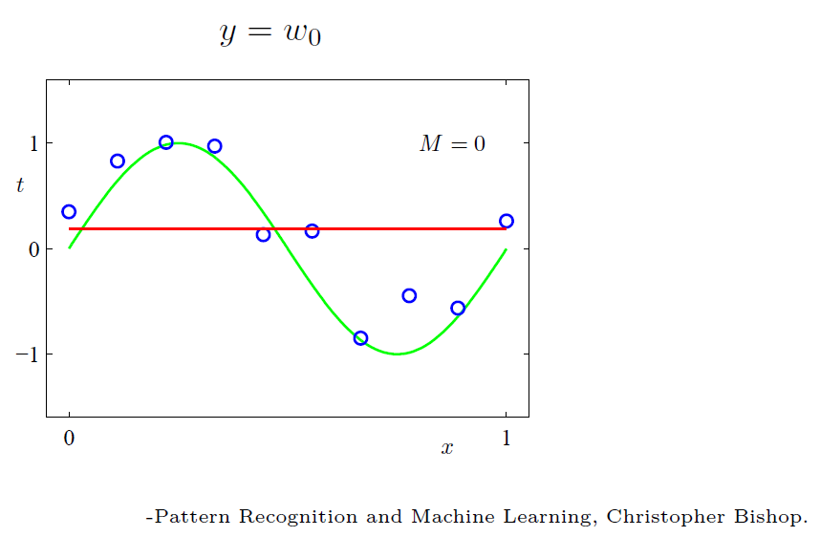

Polynomial Feature Mapping
$M$ = 0

Slide 16
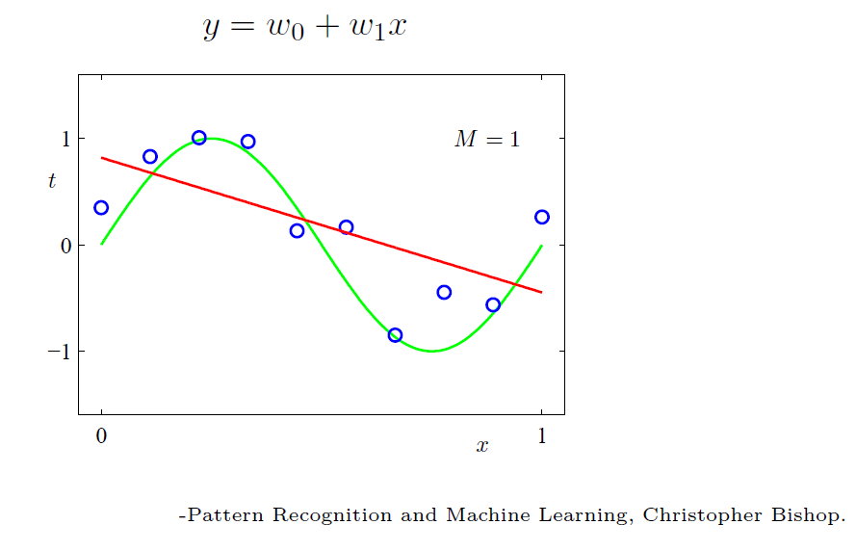

Polynomial Feature Mapping
$M$ = 1

Slide 17
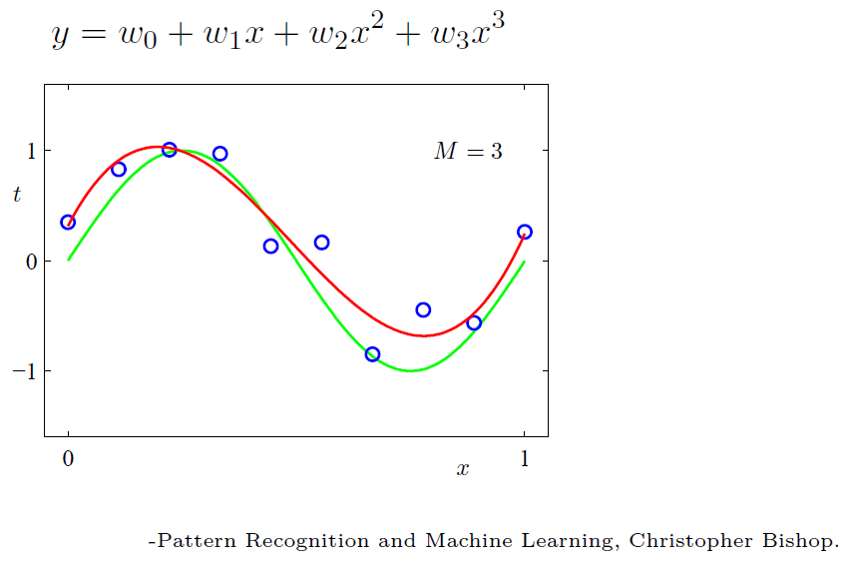

Polynomial Feature Mapping
$M$ = 3

Slide 18
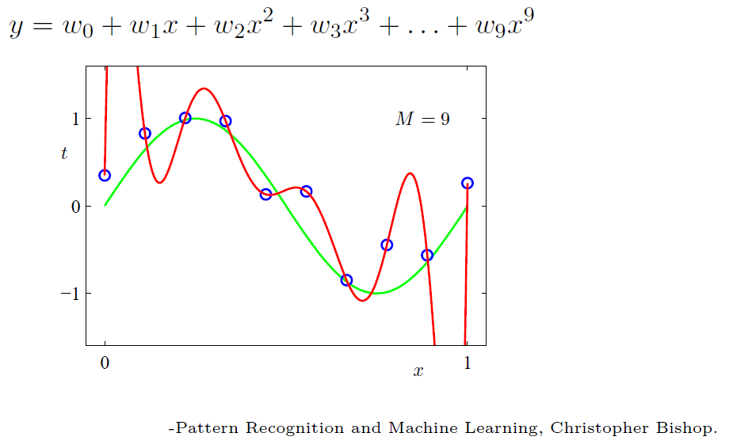

Polynomial Feature Mapping
$M$ = 9

Slide 19
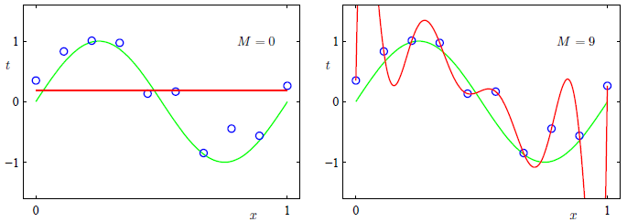
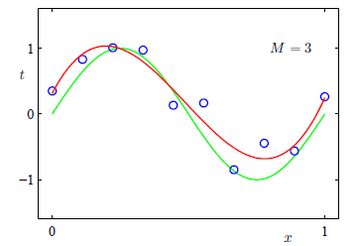

Model Complexity and Generalization
Underfitting ($M$=0): model is too simple | does not fit the data.
Overfitting ($M$=9): model is too complex | fits perfectly.
Good model ($M$=3): Achieves small test error (generalizes well).

Slide 20
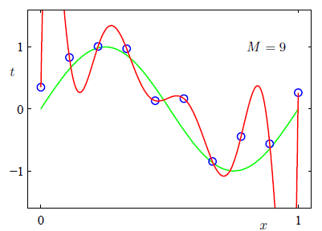
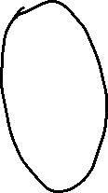
Model Complexity and Generalization
As M increases, the magnitude of coefficients gets larger.
For M = 9, the coefficients have become finely tuned to the data.
Between data points, the function exhibits large oscillations.

Slide 21
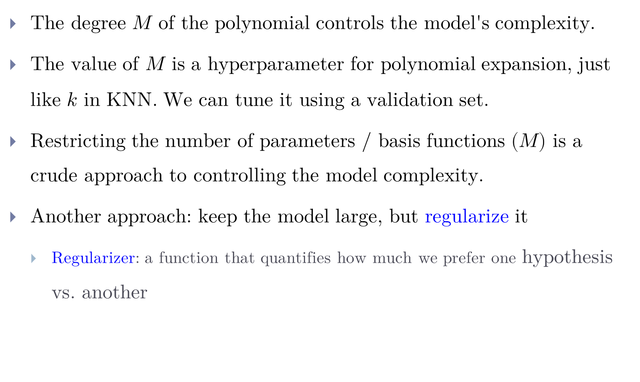
Regularization
The degree $M$ of the polynomial controls the model's complexity.
The value of $M$ is a hyperparameter for polynomial expansion, just like $k$ in KNN. We can tune it using a validation set.
Restricting the number of parameters / basis functions ($M$) is a crude approach to controlling the model complexity.
Another approach: keep the model large, but regularize it
Regularizer: a function that quantifies how much we prefer one hypothesis vs. another

Slide 22
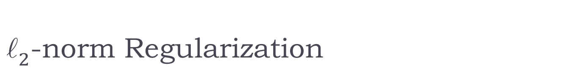

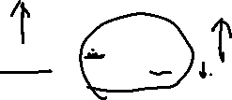

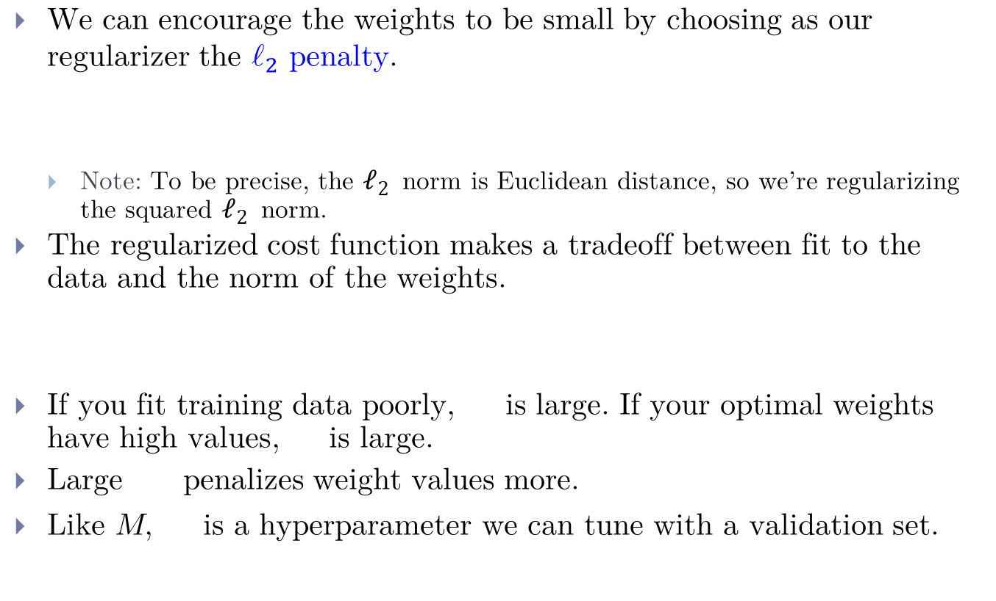

$ℓ_{2}$-norm Regularization
We can encourage the weights to be small by choosing as our regularizer the $ℓ_{2}$ penalty.
Note: To be precise, the $ℓ_{2}$ norm is Euclidean distance, so we’re regularizing the squared $ℓ_{2}$ norm.
The regularized cost function makes a tradeoff between fit to the data and the norm of the weights.
If you fit training data poorly, is large. If your optimal weights have high values, is large.
Large penalizes weight values more.
Like $M$, is a hyperparameter we can tune with a validation set.

Slide 23
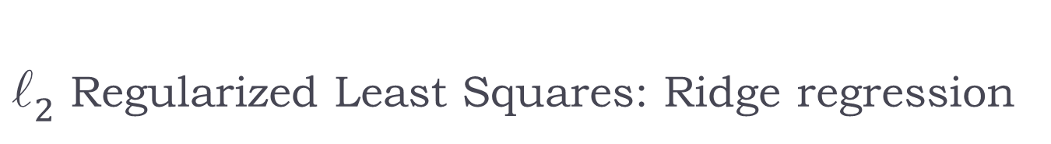

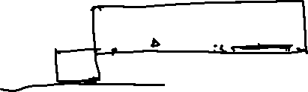






$ℓ_{2}$ Regularized Least Squares: Ridge regression
For the least squares problem, we have .
When (with regularization), regularized cost gives
The case (no regularization) reduces to least squares solution !
Note that it is also common to formulate this problem as
in which case the solution is

Slide 24

Conclusion
Linear regression exemplifies recurring themes of this course:
choose a model and a loss function
formulate an optimization problem
solve the minimization problem using one of two strategies
direct solution (set derivatives to zero)
gradient descent (next topic)
vectorize the algorithm, i.e. represent in terms of linear algebra
make a linear model more powerful using features
improve the generalization by adding a regularizer

